Slide 1
CAR PRICE PREDICTION

Slide 2
PROBLEM STATEMENT AND UNDERSTANDING
Pandemic affects in all markets , in some region it affect badly and in some region affects good. In used cars market also have a lot of change happened as compared to before the pandemic. As we know India is the second largest population country , so the use of the cars and other vehicles also should be more as compared to other countries. Even a middle class family have one car in use. Such family always look for budget friendly cars. So people look for the car which have high mileage, as we know, Petrol price is increasing in daily basis. In this situation people focus only the vehicle which have high mileage.
So we can understand that after this pandemic situation, the cars which have high mileage have high demands in the market.
As we want to predict the price of the car, we want to build regression model for this project.

Slide 3
EDA steps and Visualizations

Slide 4
EDA Steps
Dataset have around 5000 data, among them have only one missing value, we can just drop it using ‘dropna’.
When we look at the feature ‘No of owners’, it contains the same data repeating, that is it shows, First Owner and 1st owner which is same.
I replace it two one data and have the data with hyphen(-), it also replaced with First owner which is the mode of the feature.
Now the feature ‘driven kilometers’ is given ‘kms’ in the data, we want to replace it, here I replaced it using replace function.
And also the feature ‘driven kilometers’ and target variable ‘Price’ are in the object data type. We want to convert into integer.
For converting into integer, first of all we want to replace the commas(,) from the data using replace function in string.

Slide 5
After replacing the commas, here I converted using ‘to_numeric’ function in pandas.
As we want to build the regression model the target variable should be in integer or float data type. We converted it.
Now let’s check the encoding section, here I used one hot and label encoder.
In features like ‘fuel’, ’Transmission’, ‘No of owners’ used the one hot encoder.
While other features I applied Label encoder.
When we come to outliers, while removing outliers, around 8% of data will lose, so our dataset have less data when we loss it, it may be a big loss and affects in prediction.
After all features scaled.

Slide 6
Visualizations

Slide 7
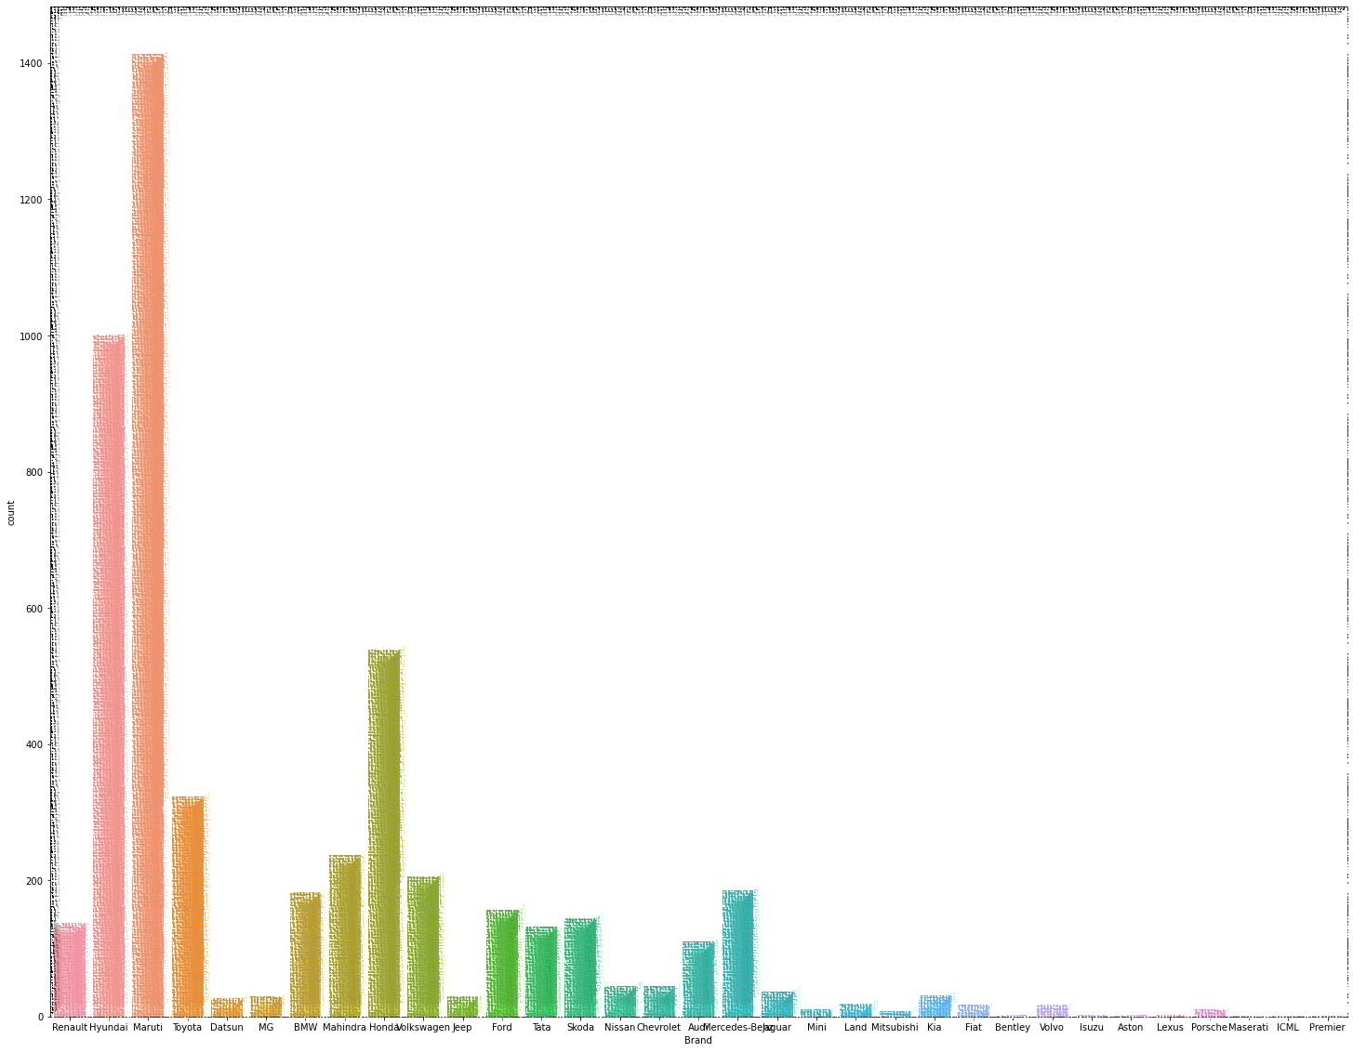

Slide 8
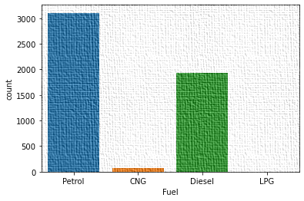
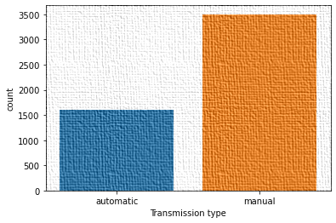

Slide 9
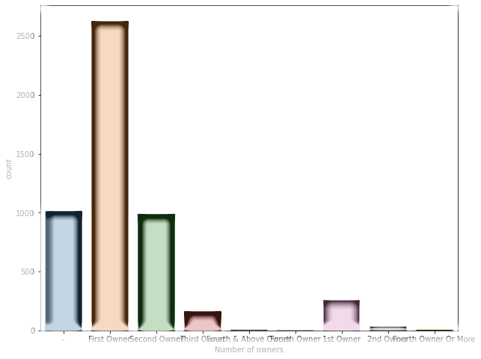

Slide 10
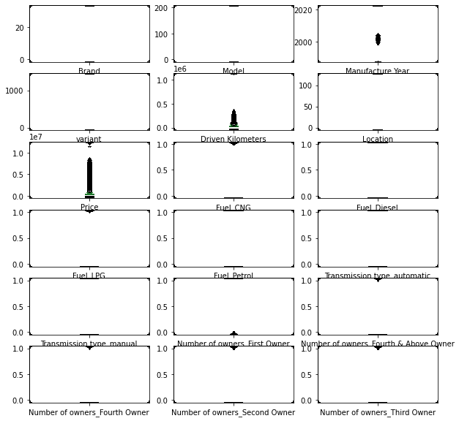

Slide 11
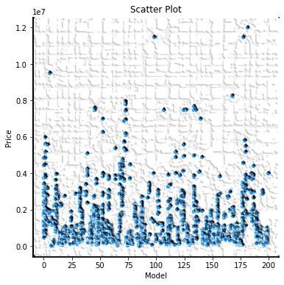
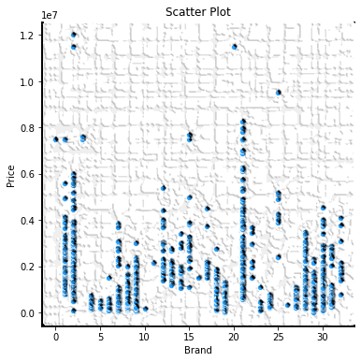

Slide 12
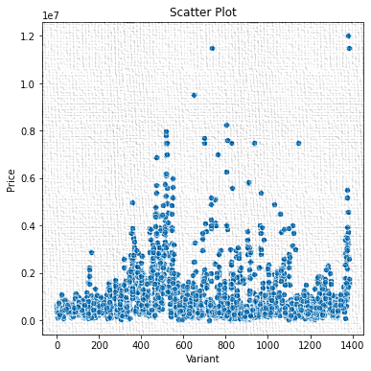
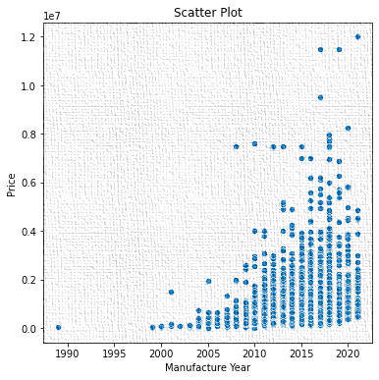

Slide 13
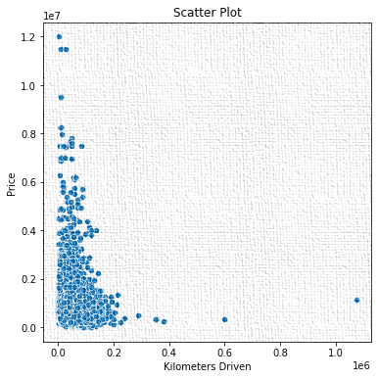
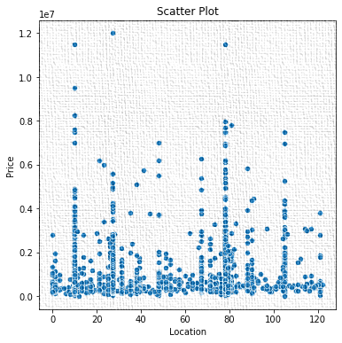

Slide 14
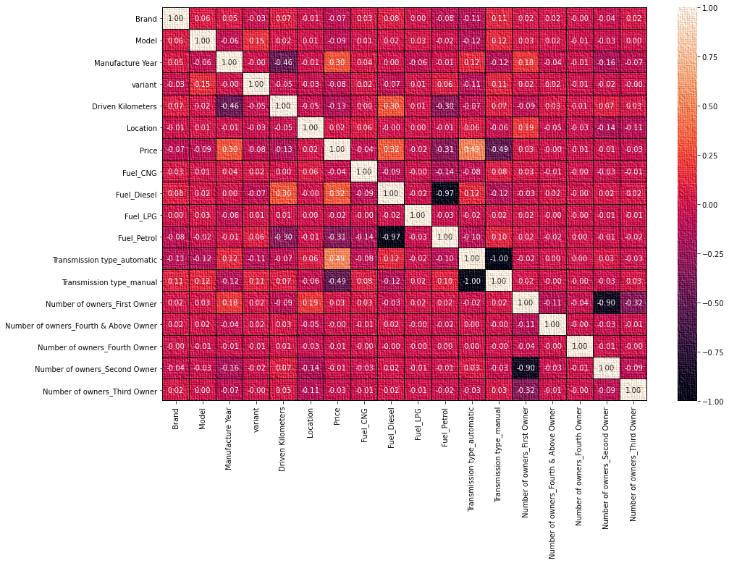

Slide 15
STEPS AND ASSUMPTIONS

Slide 16
The feature fuel type , manufacture year, transmission are correlated to price.
So we can assume that the car which gives high mileage have high demands in market . It is because the price of petrol and diesel.
According to my data, the diesel cars have high demands than petrol cars , because diesel cars gives high mileage than petrol cars.
Transmission type automatic gives more demands.
And also manufacture year, gives demands to the price.
The most important factor is the brand of car, it plays a major role in price.
The brands like Toyota, Maruti Suzuki gives high demands in the market. Because it gives high performance and mileage.

Slide 17
MODEL DASHBOARD
For a good prediction we want to select which is the best model for the given project.
So we want to perform multiple models for selecting best model.
Here in this project, I perform four different models, four of them have different R2 score.
Among them we want to select the final model and we want to mention the reason why it is final model.
We want to check the best random states , which have no over fitting or under fitting.
We want to compare the precision and recall of the model to finalize the model.

Slide 18
Which model gives equal CV(Cross validation) score and R2 score is selected as final model OR the model gives least difference in cv and R2 score also be selected.
In this project I selected random forest regressors my final model because it have least difference cv and R2 score compare to other models.
After selecting final model tune the model with best parameters, and run the model with best parameters.
Here I tuned the random forest with best parameters and got R2 score of 81%.

Slide 19
CONCLUSION
So we can conclude that the cars gives high mileage gives high demands in market.
In India , people are not looking the safety of car, they focus on the mileage.
Reason we all know that the price of petrol and diesel.
But now electric cars are releasing in India , in future it gives high demands in market.
The brand like Toyota and Maruti Suzuki cars have high demands in the market.
So the used cars agent can focus on the brand , fuel of the car in sell market of the car.

